Slide 1
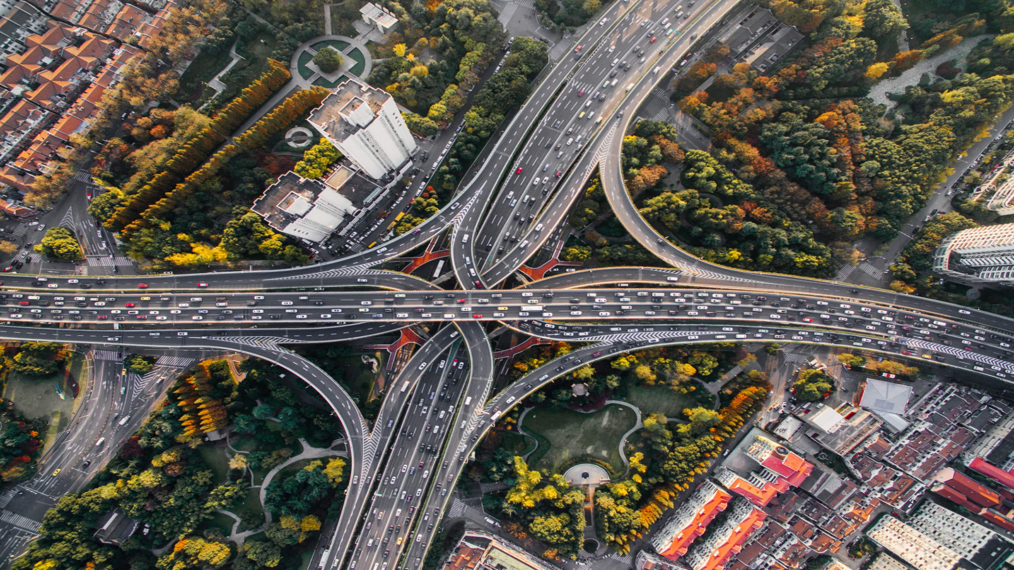
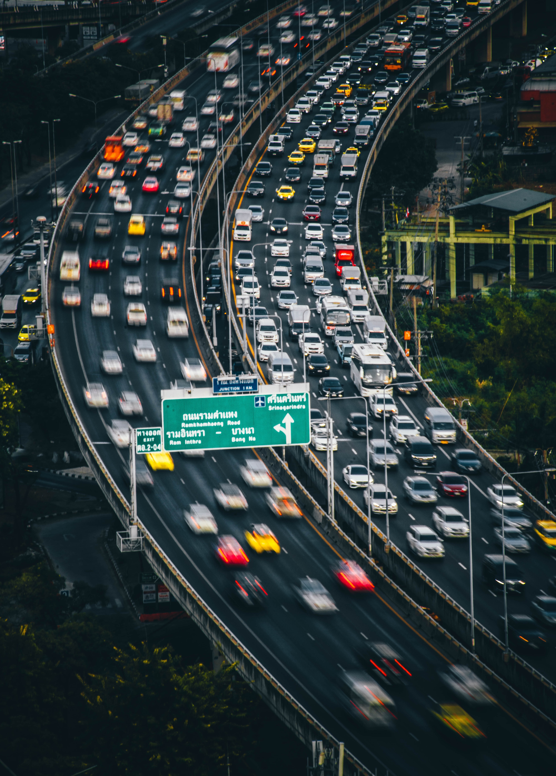
Urban Traffic Congestion
SUBMITTED BY:
ADARSH KUMAR MAURYA E23MCAG0123
YASH AGRAWAL E23MCAG0028
SWASTIK SINGH BHADOURIA E23MCAG0128
SUBMITTED TO:
Dr. NITIN ARVIND SHELKE

Slide 2
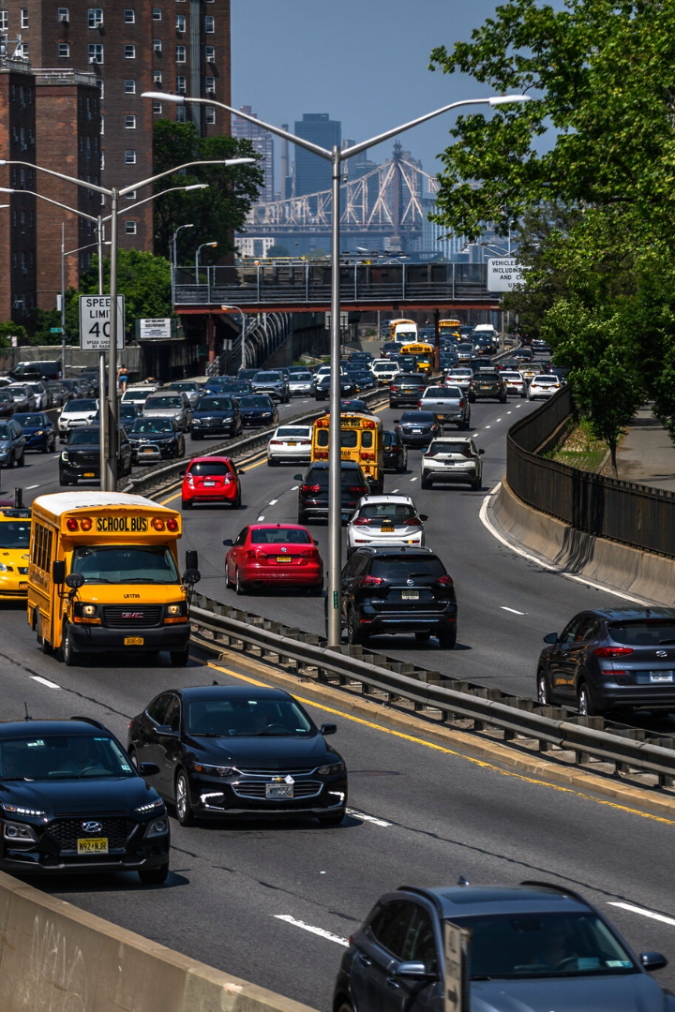
Urban Traffic Congestion
Urban traffic congestion is a major issue in cities around the world, causing frustration for drivers, increasing air pollution, and wasting time and resources. In this presentation, we'll explore the causes, effects, and solutions for this problem.

Slide 3

Causes of Urban Traffic Congestion
1
Population Density
As cities grow, there are more people and more cars on the roads.
2
Lack of Efficient Public Transit
If public transit options are scarce or unreliable, more people will opt to drive.
3
Rise of Delivery Services
Increased deliveries and online shopping lead to more delivery trucks and cars on the roads.

Slide 4
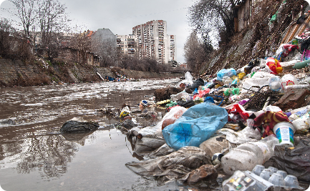
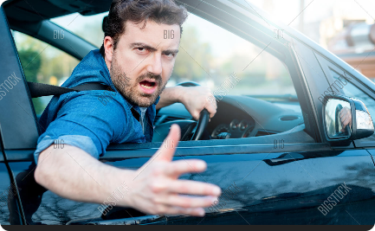
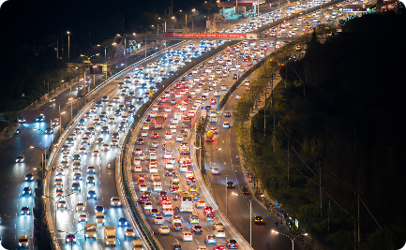
Effects of Urban Traffic Congestion
Pollution
Stress and Delay
Waste of Resources
Congestion increases air pollution, contributing to respiratory illnesses and other health problems.
Drivers spend more time in traffic, causing stress, anxiety, and frustration.
Traffic congestion wastes time and fuel, hurting productivity and the environment.

Slide 5
Solutions to Urban Traffic Congestion
Improved Public Transit
Carpooling and Ridesharing
Investing in public transit infrastructure and making it more convenient and affordable can encourage more people to use it.
Encouraging people to share rides can help reduce the number of cars on the road.
Traffic Management Strategies
Bicycle and Pedestrian Infrastructure
Using traffic management tools like smart traffic signals and real-time traffic monitoring can help reduce congestion.
Providing safe and convenient options for walking and biking can help people move around cities without using cars.

Slide 6

Public Transportation as a Solution
1
Benefits for the Environment
Using public transportation reduces air pollution and carbon emissions, making cities cleaner and healthier.
2
Convenient and Accessible
With a well-developed public transit system, riders can travel to different parts of the city quickly and easily.
3
Cost-Effective
Using public transit can be cheaper than owning and maintaining a car, especially in dense cities where parking is expensive.

Slide 7

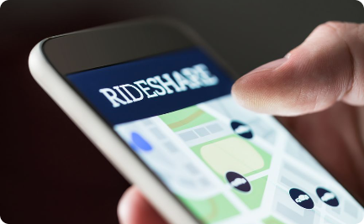

Promoting Carpooling and Ridesharing
Reduced Traffic
Convenience
Reduced Cost
Carpooling and ridesharing reduce the number of cars on the road, reducing congestion.
With the rise of ridesharing apps, finding a carpool or ride is easier than ever.
Carpooling and ridesharing can save each individual money, particularly on gas and parking fees.

Slide 8

Implementing Traffic Management Strategies
Traffic Monitoring
Congestion Pricing
Alternative Routes and Design
1
2.
3
Using technologies such as GPS data and smart traffic signals can help manage traffic flow and reduce delays.
Toll lanes, charges, and fees for high traffic areas or at peak hours can encourage drivers to change travel time or mode or use carpools or public transport.
Rerouting traffic or designing new roads, highways, roundabouts, and bike lanes can help prevent congestion hotspots.

Slide 9
Conclusion
Urban traffic congestion is a complex issue that requires creative solutions from city planners, transportation agencies, and people themselves. Investing in public transit, promoting carpooling and ridesharing, and improving traffic management can help make our cities more livable and sustainable. Traffic congestion influences economy and environment due to its manifold interactions with economic, social and environmental issues. Traffic–flow management and emission control form a significant part of sustainable transport, which demands the need to handle the issue of urban mobility and climate change. Several crucial factors cause traffic congestion and higher emission. Measures of technical and policy nature together can reduce traffic congestion and the linked environmental damage, which would possibly not sustain given the rate at which vehicular
population is growing in urban centres.

Slide 10
THANK YOU

